Slide 1
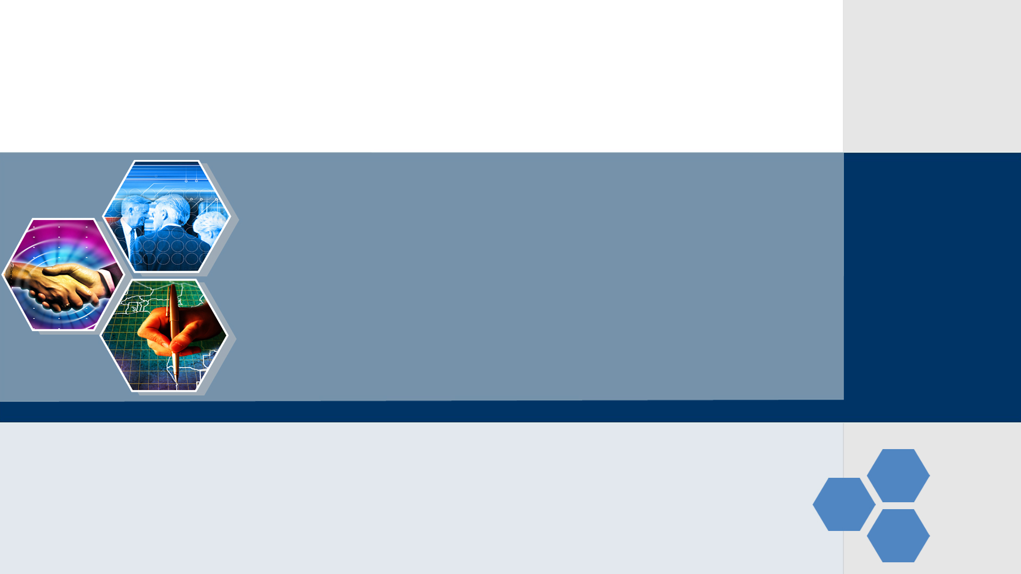
计算机网络
姚 琳

Slide 2
Who am I?
国际信息与软件学院 教授
研究方向： 大数据安全与隐私
联系方式：358371377@qq.com

Slide 3
Course Information
Course materials:
textbook: Computer Networking: A Top Down Approach
Featuring the Internet, 5th Edition, J. Kurose & Keith Ross,
Higer Education Press Class notes

Slide 4
Test
To pass this unit:
Final Exam 70%：English （10-15）+Chinese
Homework 20~15%
Attendance 10~15%
Don’t fail any component.

Slide 5
Requirement
On time.
Do not read Chinese teaching material during class, while English book is permitted.
Smartphone Addicts should disappear.
Homework had better be done by English(optional).
Homework must be done according to English textbook.

Slide 6
Goal
Everyone should pass the final exam.
A few students can write some papers for their abroad/graduate study.
A few students can apply undergraduate innovation projects for their future work/study.
A few students can join some projects of our lab.
Diligence is the most important!!!

Slide 7
Tentative Course Schedule:
Chap.1: Introduction 4 classes
Chap. 2: Application Layer 6 classes
Chap. 3: Transport Layer 12
Chap. 4: Network Layer 16
Chap. 5: Link Layer, LANs 8
Chap. 6: Wireless and Mobile Networks 2

Slide 8

A top-down approach
内容安排
Internet
协议栈
绪论
应用层
应用层
自顶向下方法
传输层
传输层
网络层
网络层
数据链路层
数据链路层
无线网络
物理层

Slide 9
What can you learn from this course?
Understand the basics of computer networks: design and practice
Understanding of the mainstream computer network technology and design principles
Learn the basics of TCP/IP protocol suite in the current Internet
Understand the latest development of the network technology.

Slide 10
Acknowledgements
Some materials used in this course (and the slides) were downloaded from the Internet. Copyright and all rights therein are retained by the corresponding copyright holders.
The PPT slides are basically adapted from the slides created (and copyrighted) by J.F Kurose and K.W. Ross for their book “Computer Networking”.

